Slide 1
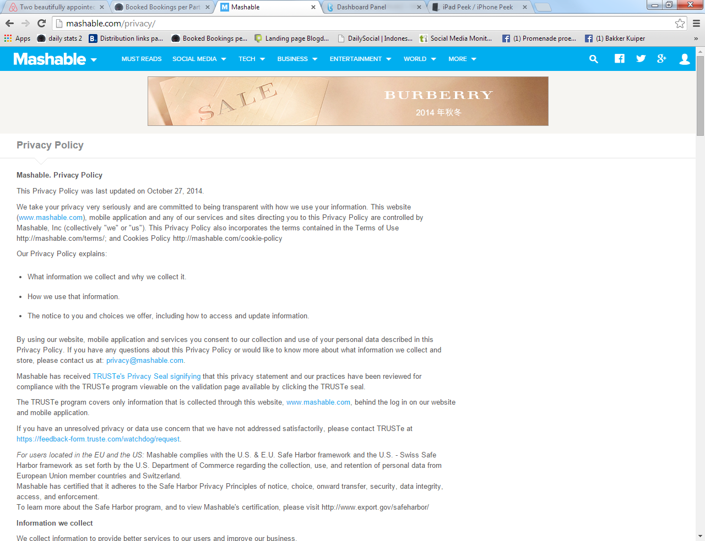

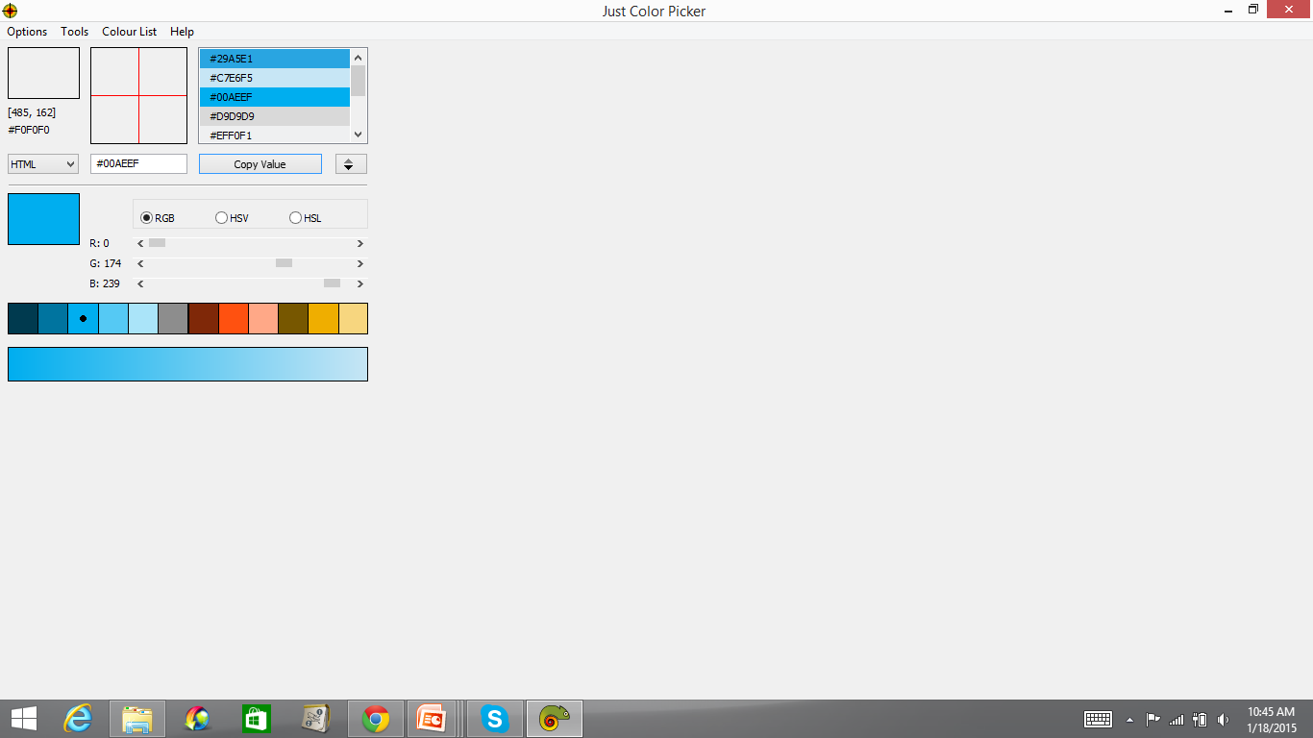
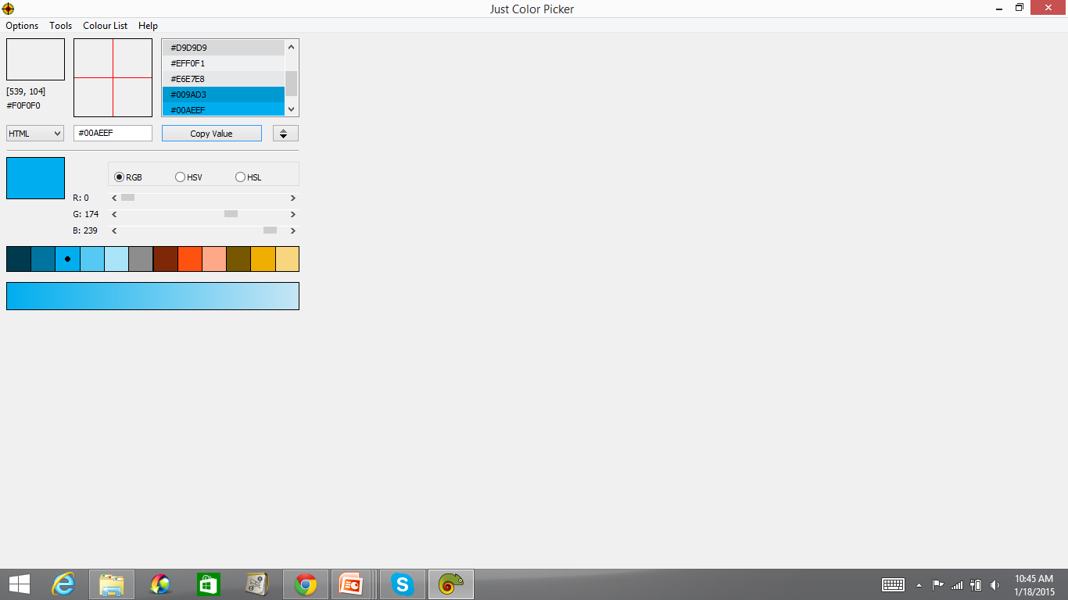
1. Show me 2 new versions of the logo.
#00AEEF
Please change the color on the logo
to make it match better with #00AEEF
Background.
Use my colors and propose different
colors.
Please show me at least 2 versions.

Slide 2
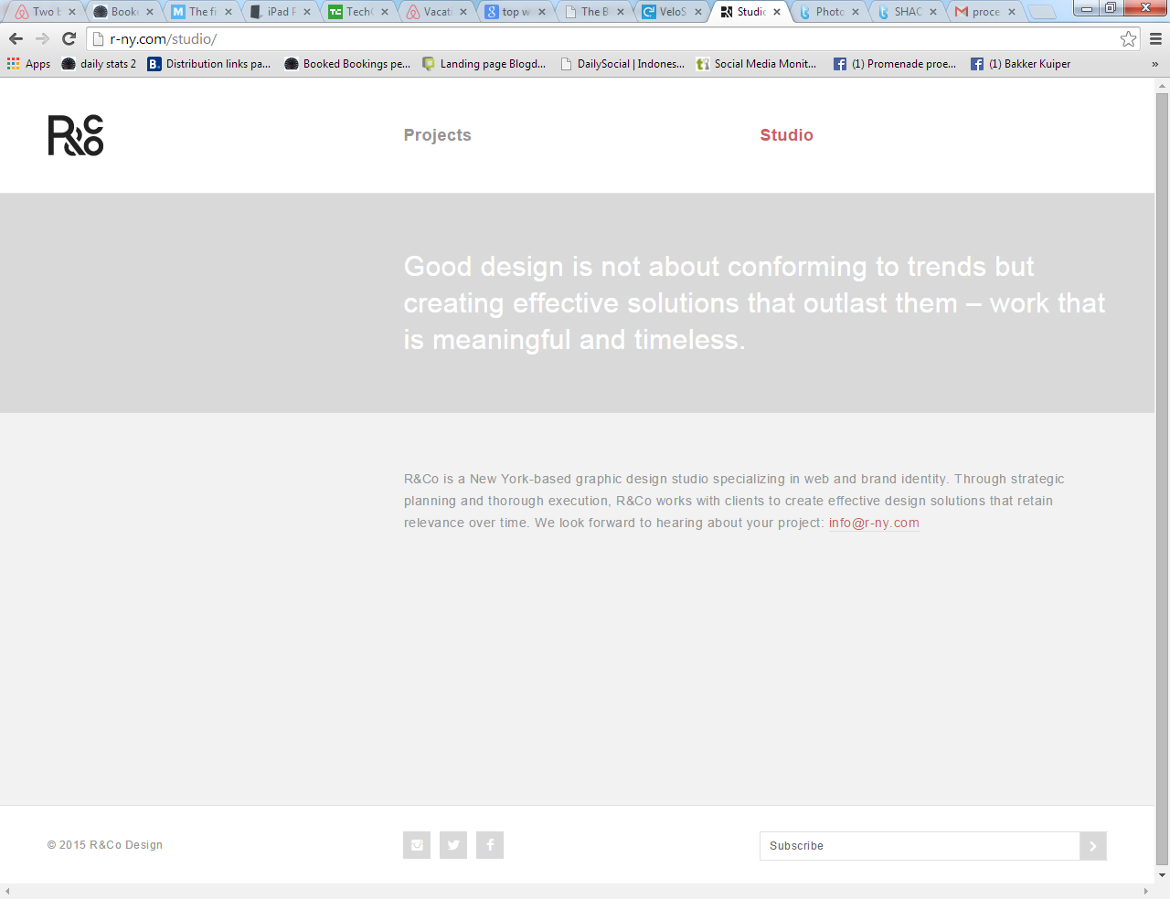
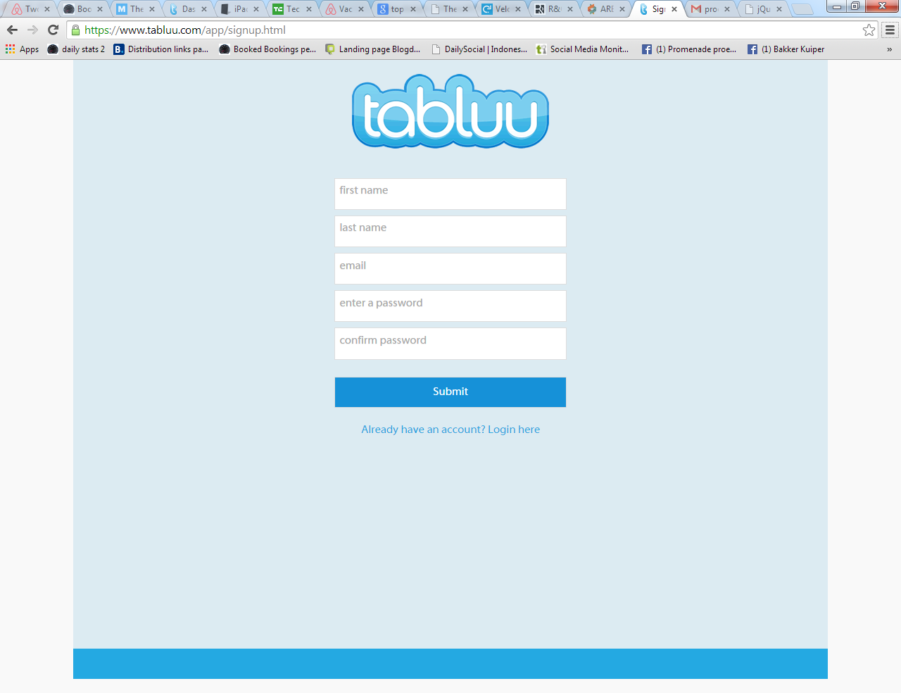
Please refer to the sign up page below:
https://www.tabluu.com/app/signup.html
Use the width for the new home page…

Slide 3

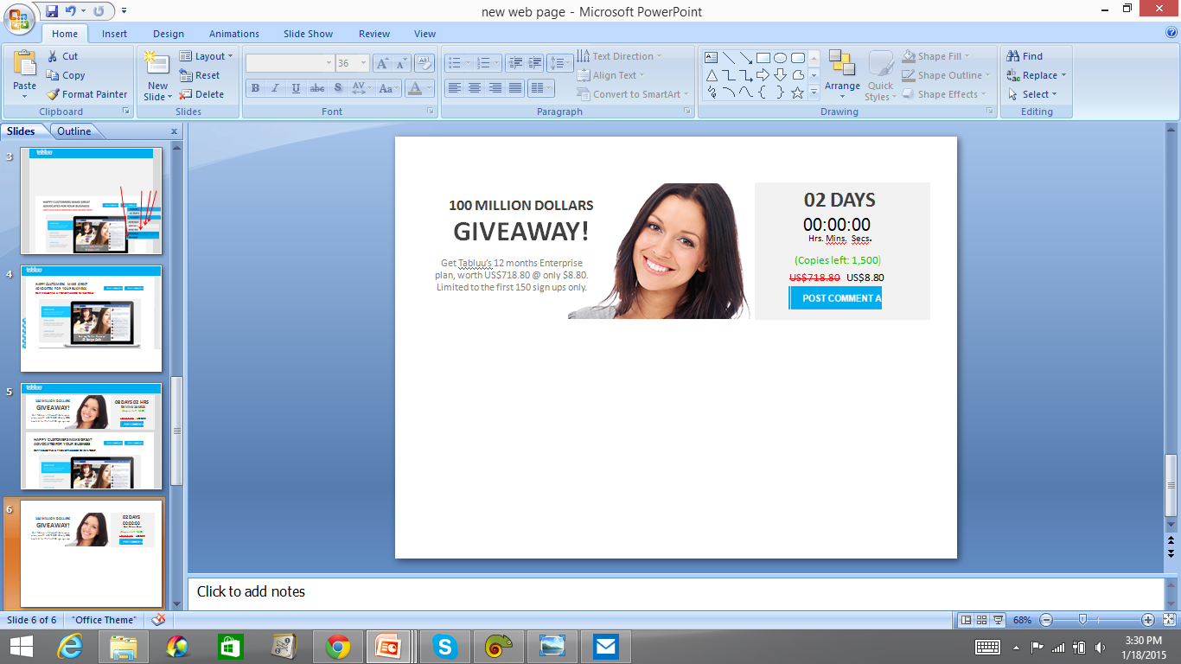
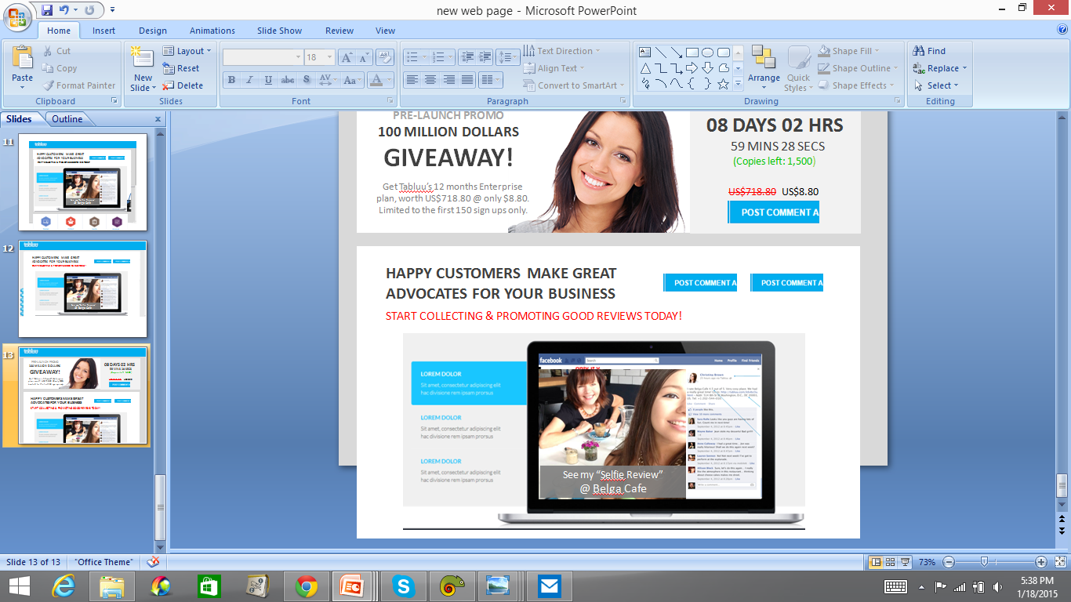
2. Create the home page like this…
SIGN UP NOW
Add “PRE-LAUNCH CAMPAIGN” here.
“SELFIE REVIEWS”

Slide 4
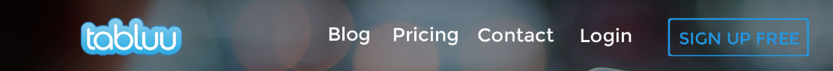
SIGN UP NOW
Add WHITE fonts like this to the blue header.
Change to “SIGN UP NOW”
Make it white boxes.
Make a simple footer like below
Privacy Policy Terms Contact Us

Slide 5

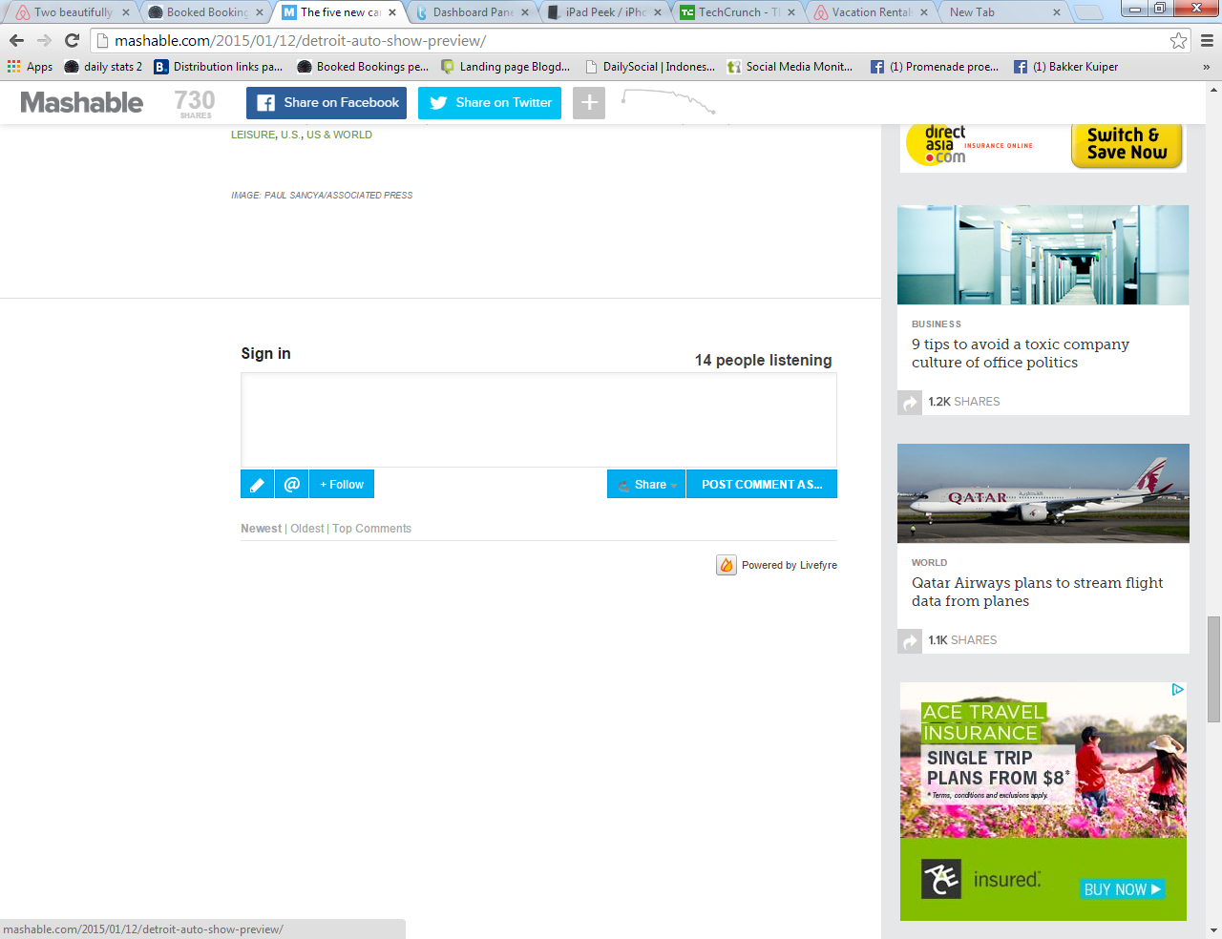
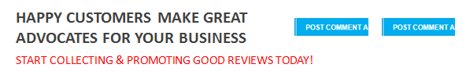
Add “PRE-LAUNCH CAMPAIGN” here.
00 DAY(S)
100 MILLION DOLLARS GIVEAWAY!
00:00:00
Hrs. Mins. Secs.
Get Tabluu’s 12 months Enterprise plan, worth US$718.80 @ only $8.80. Limited to the first 150 sign ups only.
(Copies left: 1,500)
US$718.80 US$8.80
http://mazzadental.info/sites/default/files/public/styles/large/public/Woman_white_background.png?itok=HWBh8kja
GET IT NOW!
SEE PRICING
START NOW

Slide 6
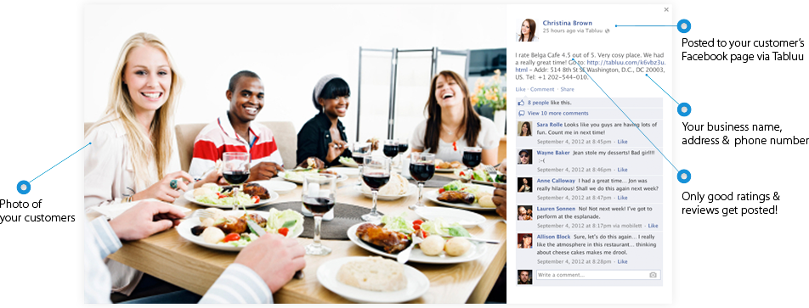
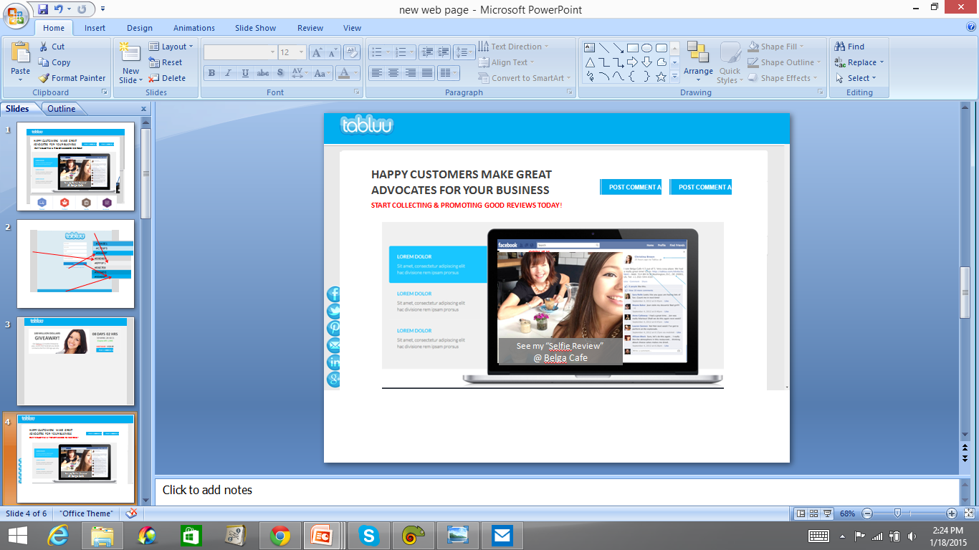
Remember this?
Remove all blue lines
and words in red circle.
Put the image in a notebook.
This image is available from my attached files.
Put a Facebook header on top of the image.
Please go to Facebook to do the screenshot
and photoshop it.
https://leeannewalker1.wordpress.com/2014/02/10/weekly-photo-challenge-selfie/
Please add a grey section below the image.. With words..
See my “Selfie Review”
@ Belga Cafe
Sightly smaller fonts.

Slide 7
See my "Selfie Review" of Belga Cafe here! http://tabluu.com/k6vbz3u.html, Belga Cafe, 514 8th St SE Washington, D.C. DC 20003 US, +1 202-544-010.

Slide 8
Make this section appear
on the right instead.

Slide 9
When the buttons are clicked, a section in the screen will be highlighted.
Therefore, we need 3 images for the screen.
Your good reviews & contact details posted!
What’s more! Customers on a mobile smart phone may call your business directly from their phones.

Slide 10
Customers advocacy in action!
Your customers engage their friends while your business gets promoted!

Slide 11
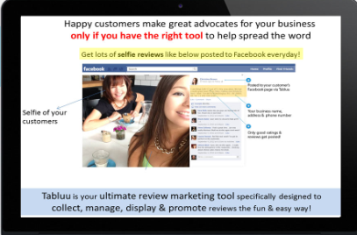
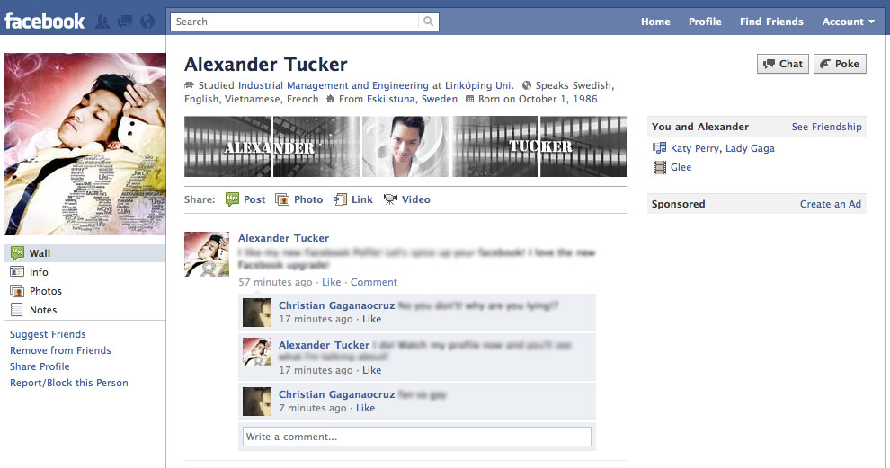
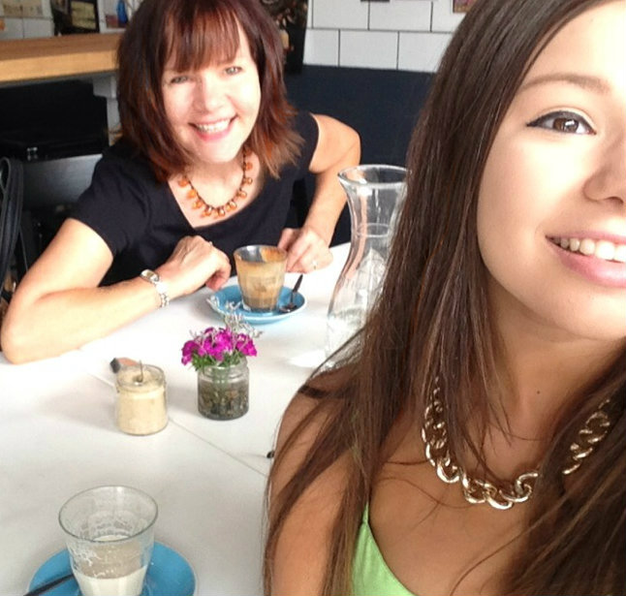
See my “Selfie Review”
@ Belga Cafe
Strong call to action using “Selfie Reviews”
Tabluu asks your customers’ friends to visit your high converting Tabluu (business) page!

Slide 12
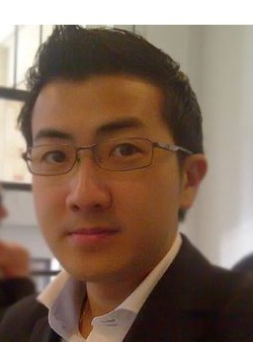
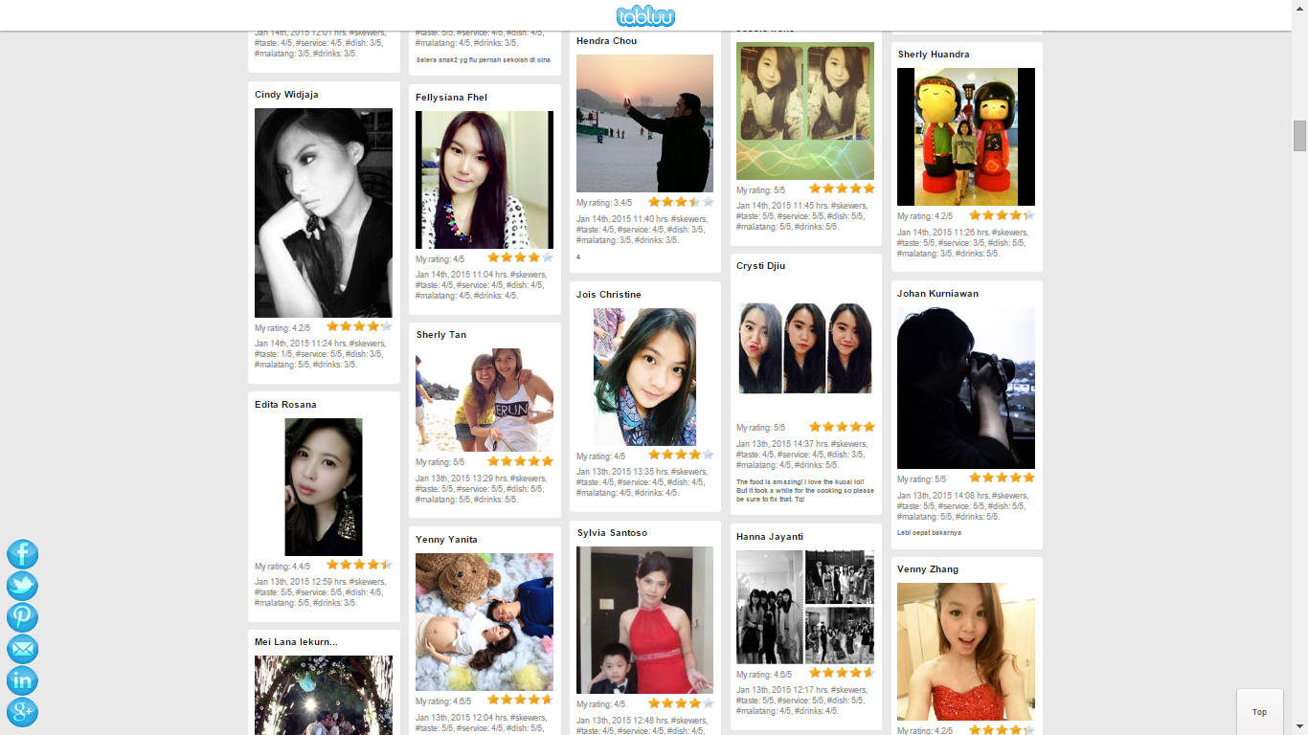
3. Create the testimony section…
https://media.licdn.com/mpr/mpr/shrink_500_500/p/5/005/071/248/29a41b0.jpg
WHAT OUR BETA USERS ARE SAYING…
“Tabluu’s revolutionary concept of review marketing is brilliant! Who would have thought that getting customers to share ‘SELFIE REVIEWS’ is so easy & effective! The killer is in the details & Tabluu nailed it! Our phone is definitely ringing a lot more these days. Sales increased 43% even though we cut our marketing spending by 70%! We are now leasing more space to cater for additional business & we rely solely on Tabluu to spread the word . Why not? Tabluu simply outperforms any social media marketing tools in the market now.”
Han Tjandra, Co-Founder
SHAO KAO PIK Restaurant
Jakarta, Indonesia
SHAO KAO PIK Restaurant - 752 “selfie reviews”, 645 followers, 9,345 new visitors & counting! 43% increase in business!

Slide 13
SIGN UP NOW
Link to this page…
https://www.tabluu.com/09z9wxb.html
Change text of the button to…
See it here!
SHAO KAO PIK Restaurant - 652 “selfie reviews”, 545 followers, 9,345 new visitors & counting! 43% increase in business!

Slide 14
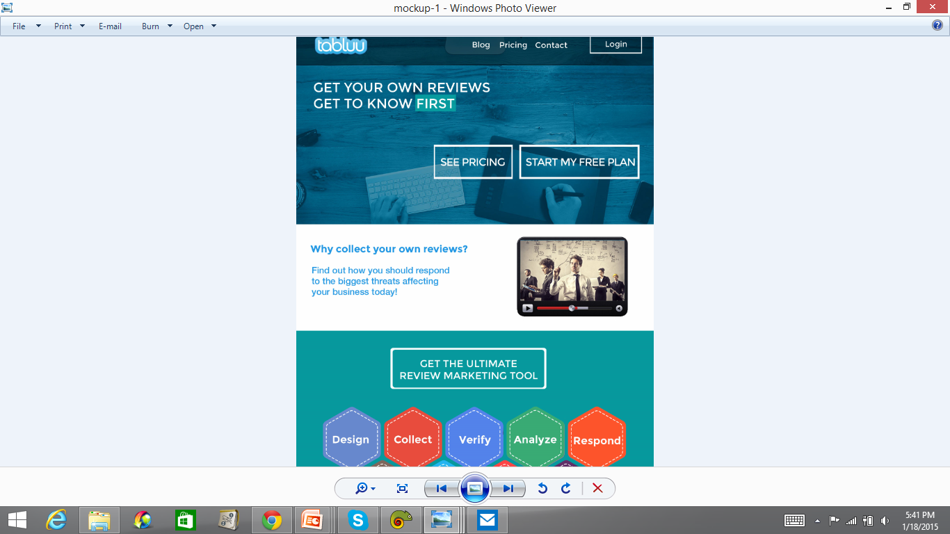
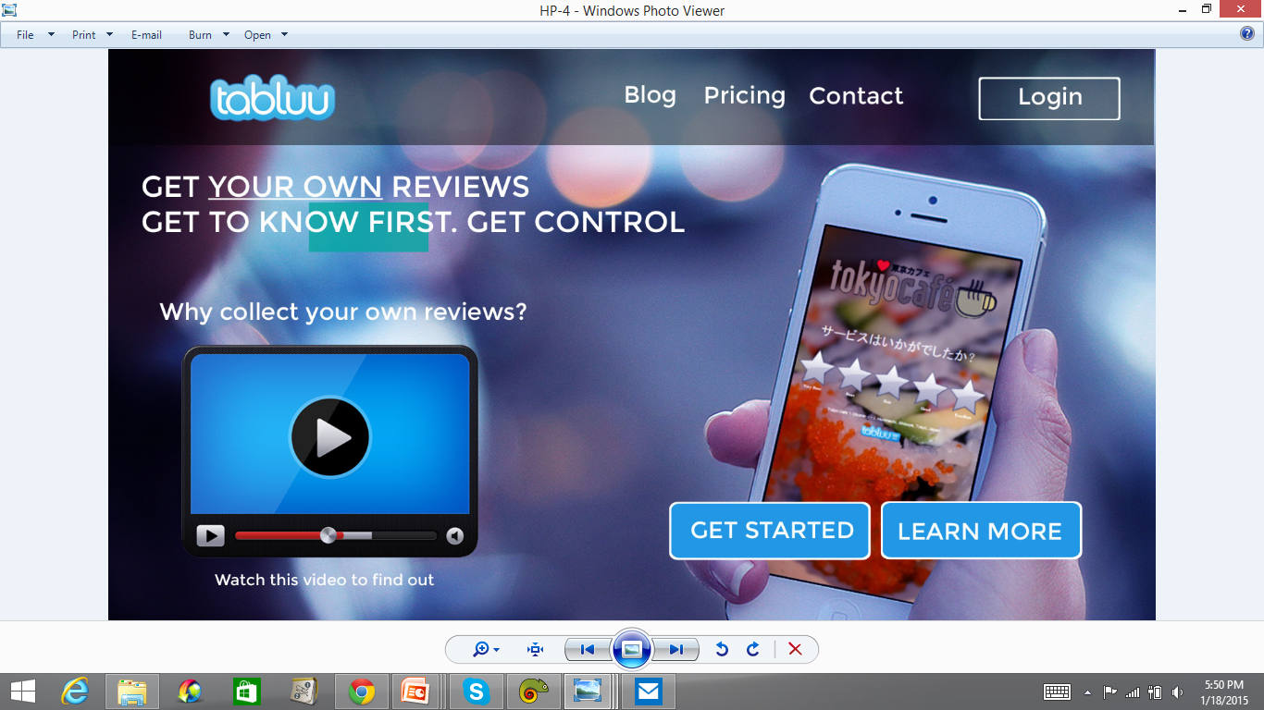
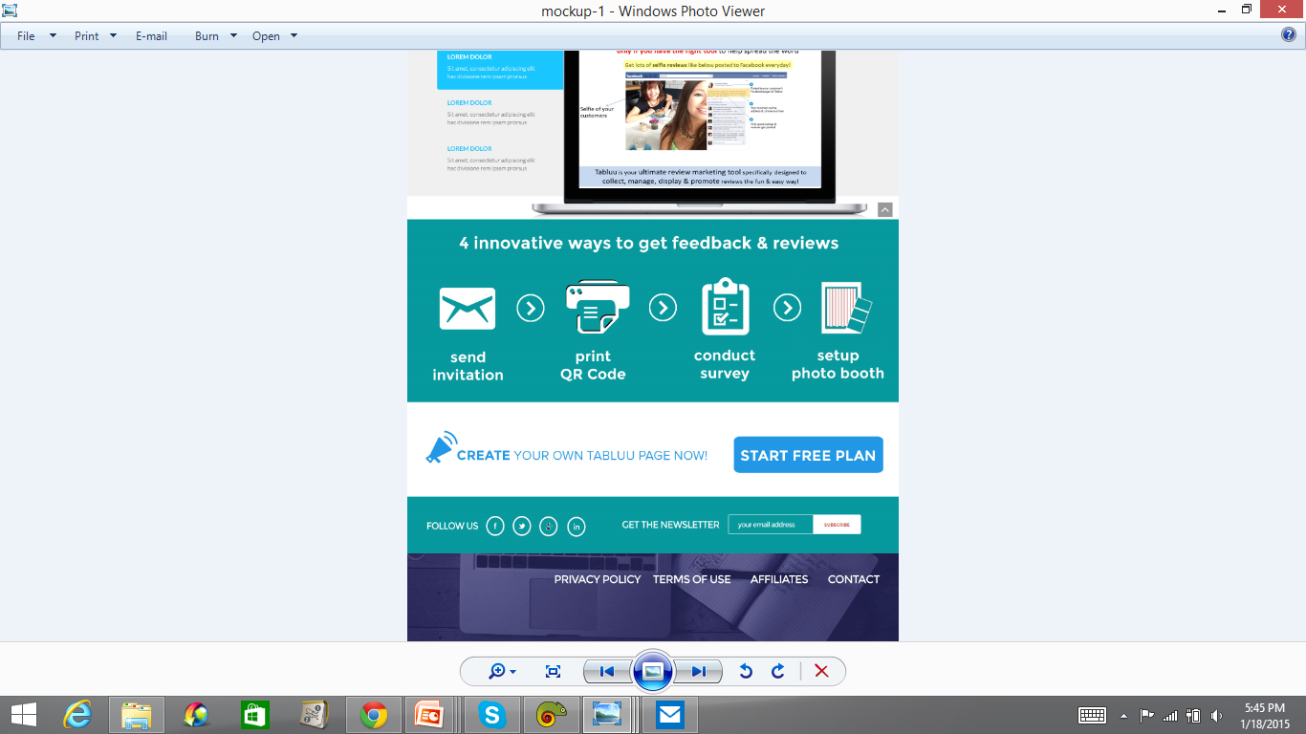
4. Create below 2 more sections.
There should be 6 icons on this section.
See next page!

Slide 15


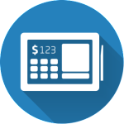
There are 2 rows in this section
Each row has 3 icons…
Innovative ways to collect feedback & reviews
email
invitations
survey
photo booth
QR codes
feedback stations
post selfie

Slide 16

I manage to find the below icons. We do not need them to be in a circle shape.
Please feel free to change the icons if you find better ones.
http://www.evosnap.com/wp-content/uploads/2014/02/icon-pos-150x150.png
Use “pos icon” to search.
http://icons.iconarchive.com/icons/martz90/circle/512/camera-icon.png
http://www.simmsmobile.com/uploads/3/7/5/9/37597045/3593623_orig.png

Slide 17
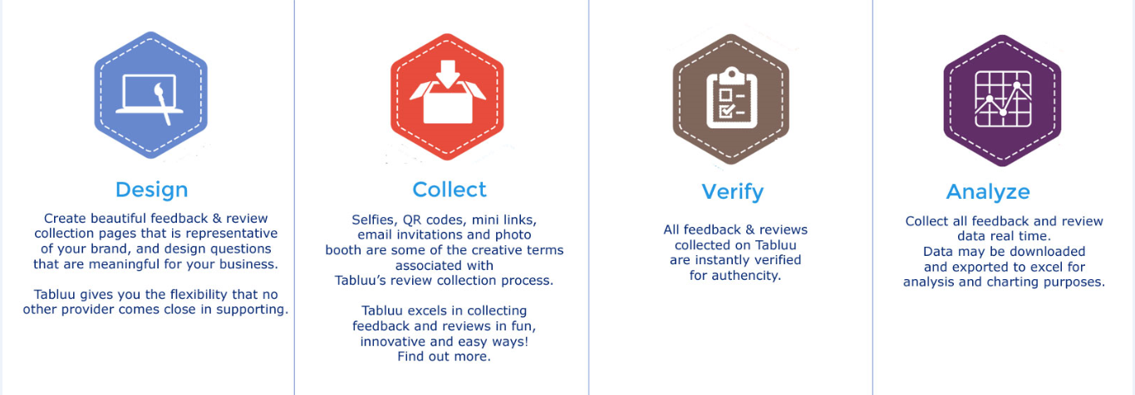




5. Create last section in home page...
http://www2.psd100.com/icon/2013/09/1001/list-icon-0910124959.png
https://researchresults.files.wordpress.com/2014/05/forum-response-icon.png
Respond
Manage
Promote
Display
START MY PLAN
START COLLECTING & PROMOTING GOOD REVIEWS TODAY!

Slide 18
SIGN UP NOW
Please make a blank page like this…

